Slide 1
Catchy
Desktop Log Viewer for Embedded and Android Debugging
A unified platform for log analysis and real-time logcat monitoring
Designed for large-scale log files, structured filtering, and workflow optimization
Improves debugging speed, traceability, and usability compared with manual inspection
Catchy
Log viewer
Live stream
Search
Bookmark
Screen Copy

Slide 2
Problem Statement
Limitations of the Existing Tool
Large log files are difficult to process efficiently without noticeable delays
Search and filtering operations are insufficient for rapid debugging workflows
The user must switch contexts between viewing logs and monitoring device activity
Important events are harder to trace and revisit during repeated debugging cycles
The existing workflow does not support smooth live investigation and structured analysis
Bonnibel.exe
Limited workflow
Slower triage

Slide 3
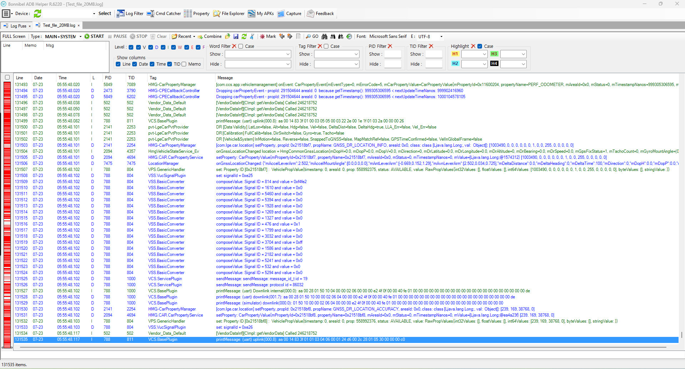
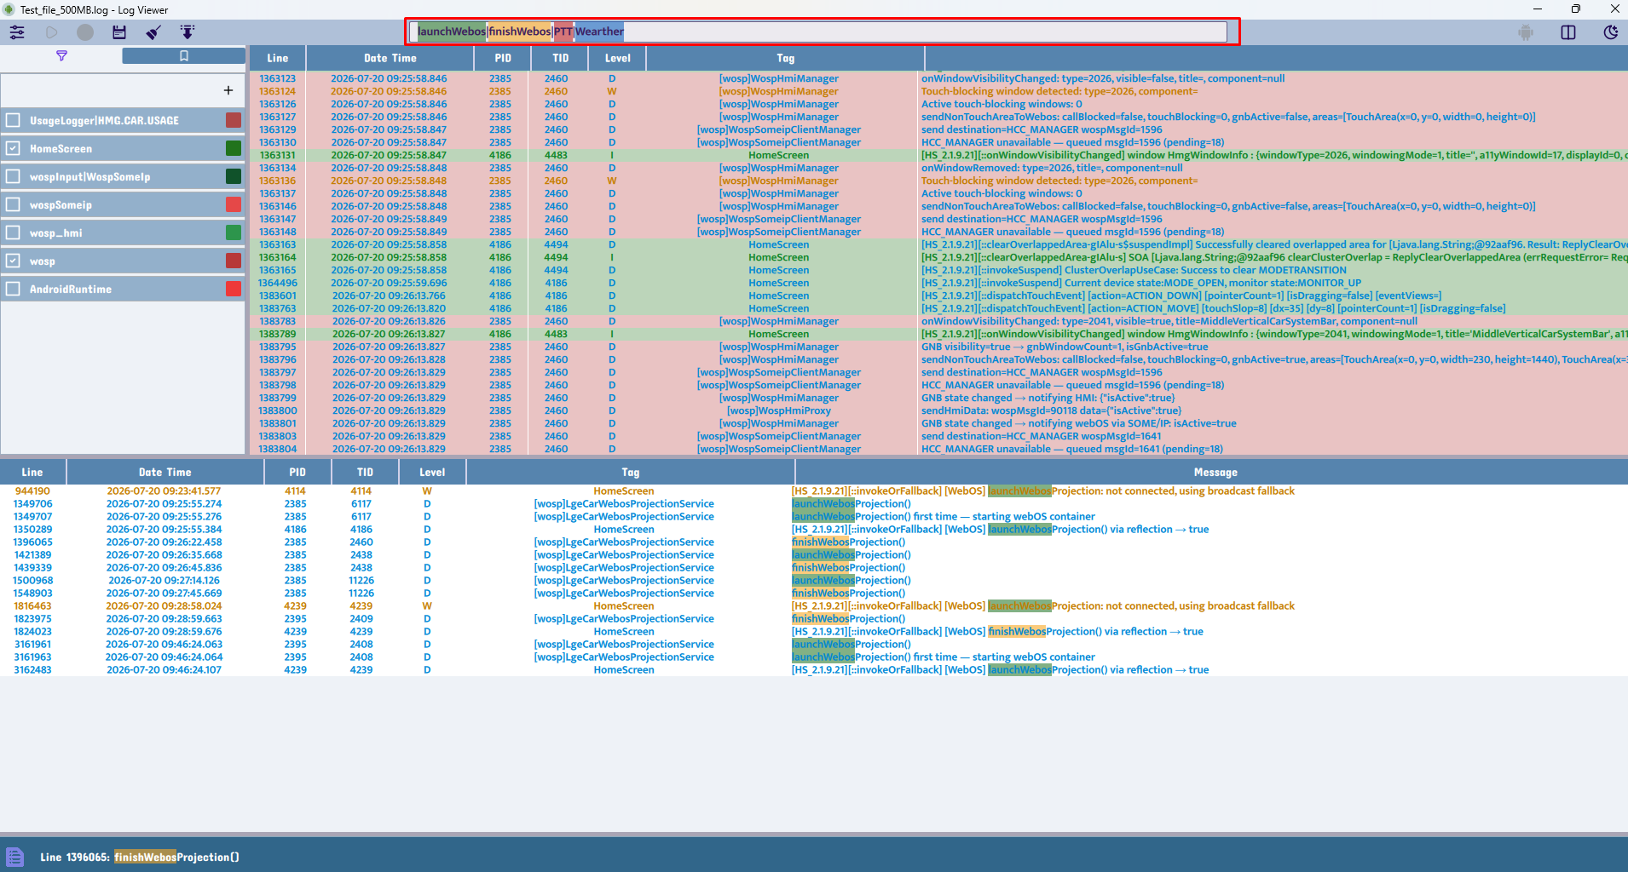
Comparative Evidence
Legacy Tool Versus Proposed System
The updated interface demonstrates a clearer layout, reduced operational friction, and a more efficient debugging workflow.

Slide 4
Performance Evaluation
Measured Loading-Time Comparison
File size | Catchy | Bonnibel.exe
20 MB | under 2s | under 2s
100 MB | 3s | 9s
250 MB | 6s | 20s
500 MB | 12s | 45s / occasional UI freeze
Result: Catchy maintains responsiveness even with large log files, whereas the legacy tool experiences noticeable delays.

Slide 5
Evidence of Improvement
Major Bottleneck Reduction and Enhanced Usability
500MB logs load in approximately 12 seconds in Catchy, compared with about 45 seconds and occasional UI freezing in Bonnibel
The adaptive interface maintains responsiveness while streaming live logcat data
Automatic ADB state detection reduces user errors and improves operational reliability
Keyboard shortcuts and workflow automation significantly reduce manual navigation and debugging effort
The system now supports continuous monitoring with a 500MB retention window and smooth scrolling performance

Slide 6
System Architecture
QML UI
Controller
Log Model
Filters
Search
Bookmark
The application follows an MVVM-inspired structure with worker threads to support large-file loading and live streaming.
The controller coordinates the core logic, while the QML layer ensures responsive visual updates and efficient user interaction.

Slide 7
Core Functional Features
Large-file processing with progress indicators and worker-thread execution
Live logcat streaming with auto-scroll and real-time refresh
Multi-keyword highlighting using color-coded matching for rapid analysis
Named filters for process and tag-based debugging workflows
Bookmark system for saving and revisiting critical log entries
Scrcpy integration for device-side visual verification and validation

Slide 8
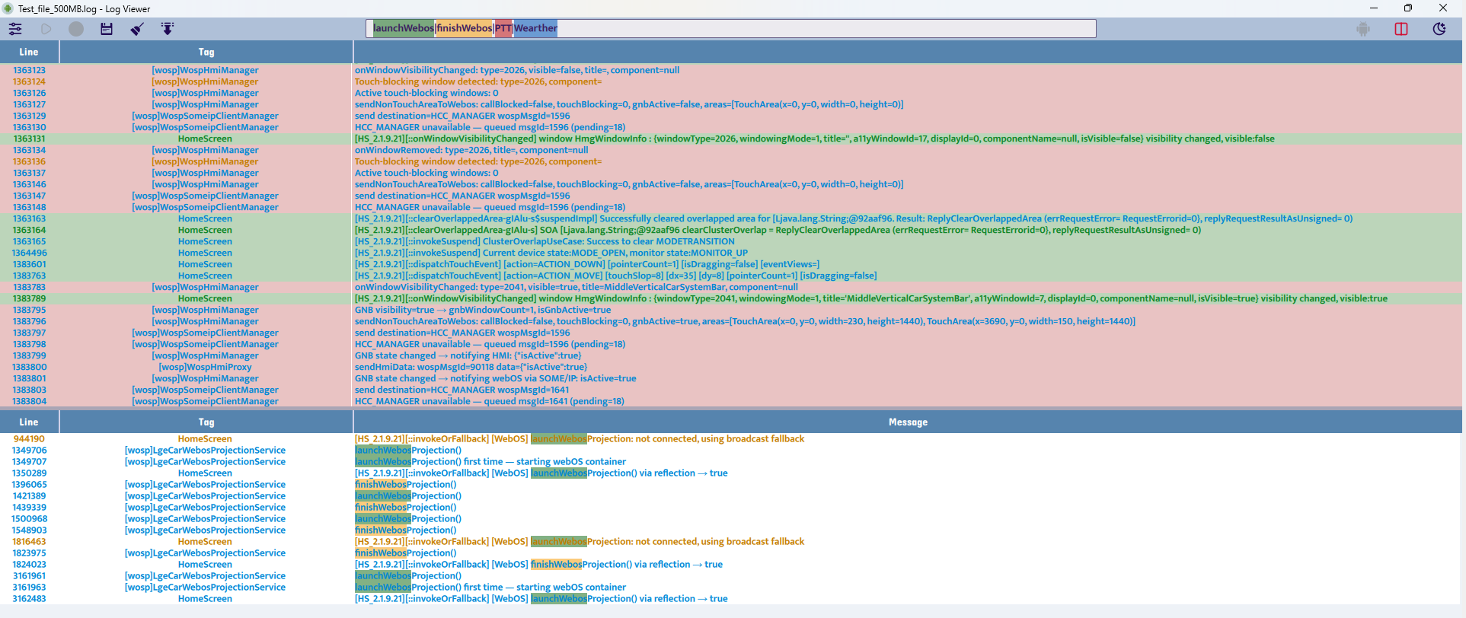
Full Log Viewer UI
Main view with log table and filtering controls
The full log viewer provides a readable, structured interface for large logs, making analysis more efficient than a text-heavy legacy tool.

Slide 9
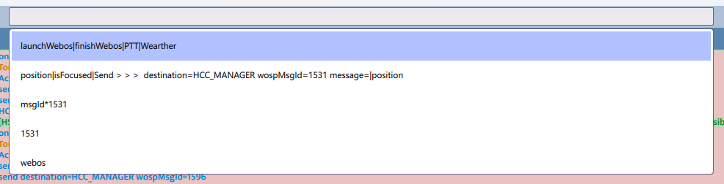
Long Search Box
Quick keyword search and result navigation
A dedicated search bar enables fast keyword search, better visibility, and quick navigation to relevant log entries
Show the hint of the history whey typing the work to search (Ctrl + Space)

Slide 10
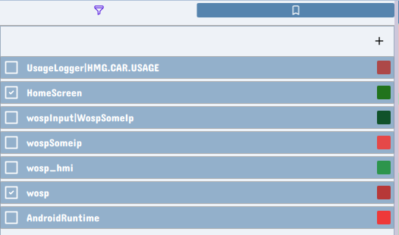
Tag Filter Panel
Color-coded tag and process filtering
Named filters and color coding make it easy to isolate important processes and reduce noise in large log sets.

Slide 11

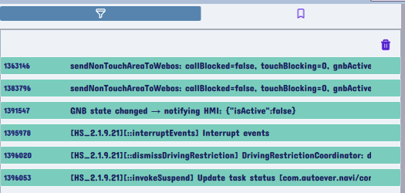
Tag Filter and Bookmark Panel
Filter management and bookmark workflow
To mark the line: click to the line to select, right click to show the menu
The left-side panels allow users to monitor active filters and bookmarks without leaving the main debugging context, click to jump to the line of the bookmark
Click the bookmark to jump the line is marked and see around source code

Slide 12
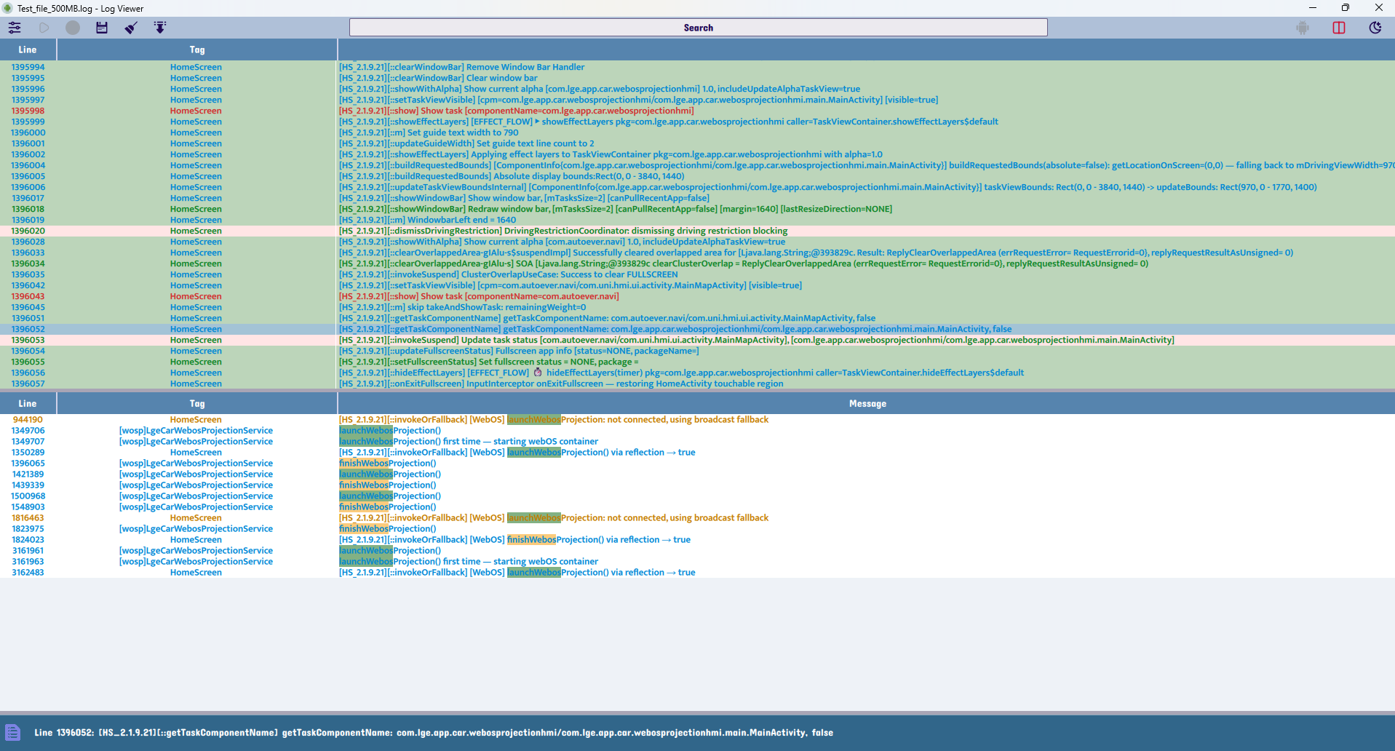
Split View for Long Content
Readable handling of expanded log content
The split layout keeps long line content readable and avoids the cramped interface that makes debugging difficult.
Search with two layers: First search by tag, then search by word based on data are searched by tag

Slide 13
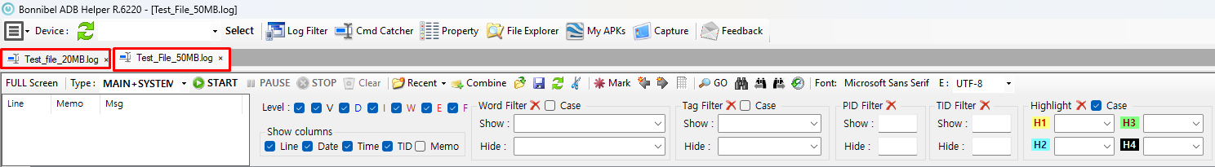
Problems: Need to check multiple log files
Already know solution 1: Open with multiple tabs
Take time and need to remember each time switch the tab
Already know solution 2: Merged all logs file need to check in one file
Write some script(.bat, .py, …) to merged the log fist
=>Then combine them to a file and check as normal
The Tool Solution: Merged The file in the tool with open add file or drag to merged.
=> Make them as a file in a tab only

Slide 14
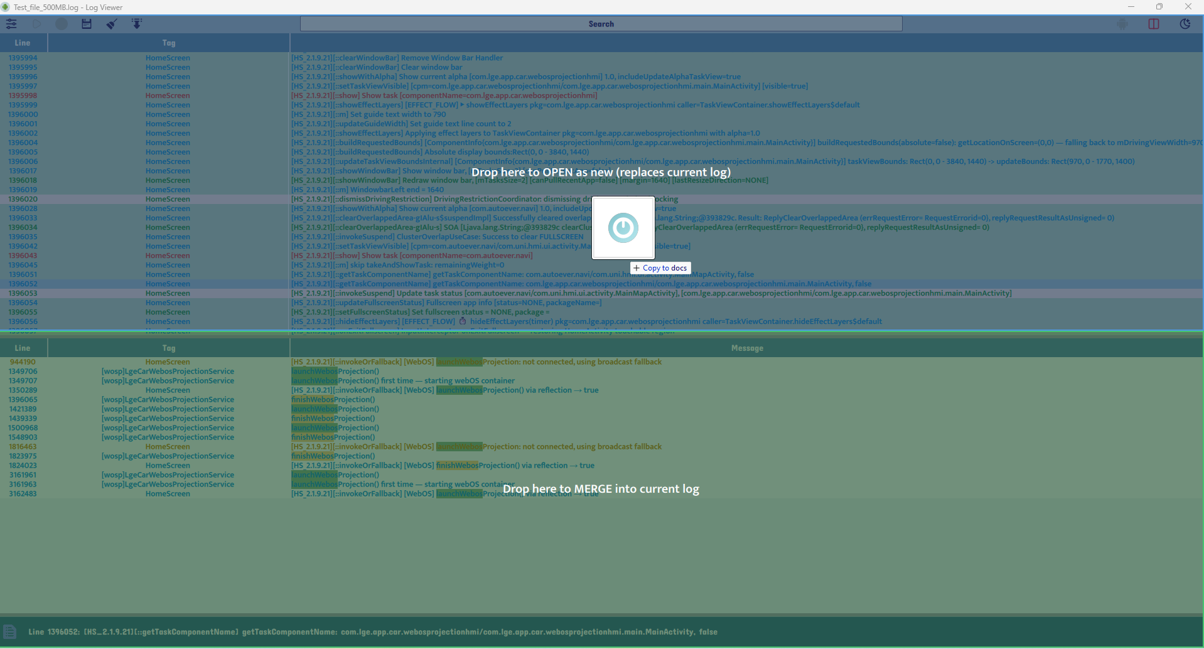
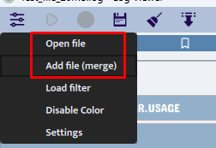
Open as new or merged (already load log before)
Open new file: Drag to the top of half screen => Open as a new log (clear all old memory)
Merged file: Append the logs to the buffer and show in 1 tab

Slide 15
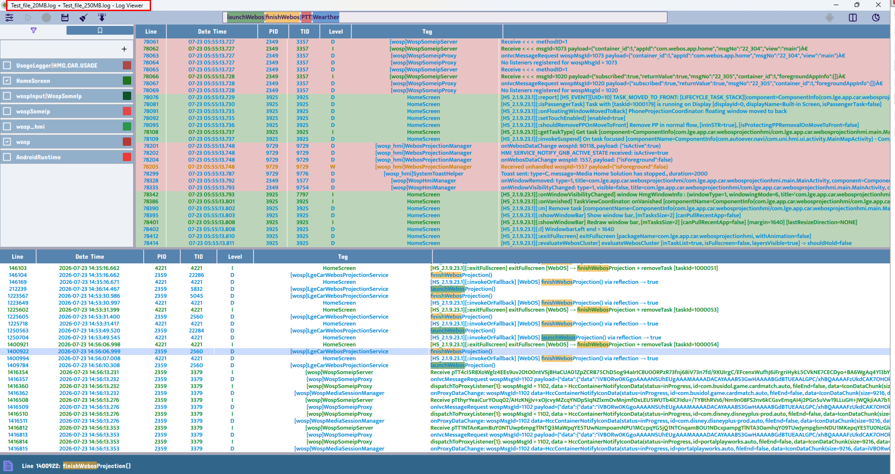
UI after log files are merged
After merging: The UI displays the logs as a single open file.
File name: The new file name combines the names of all merged log files.

Slide 16
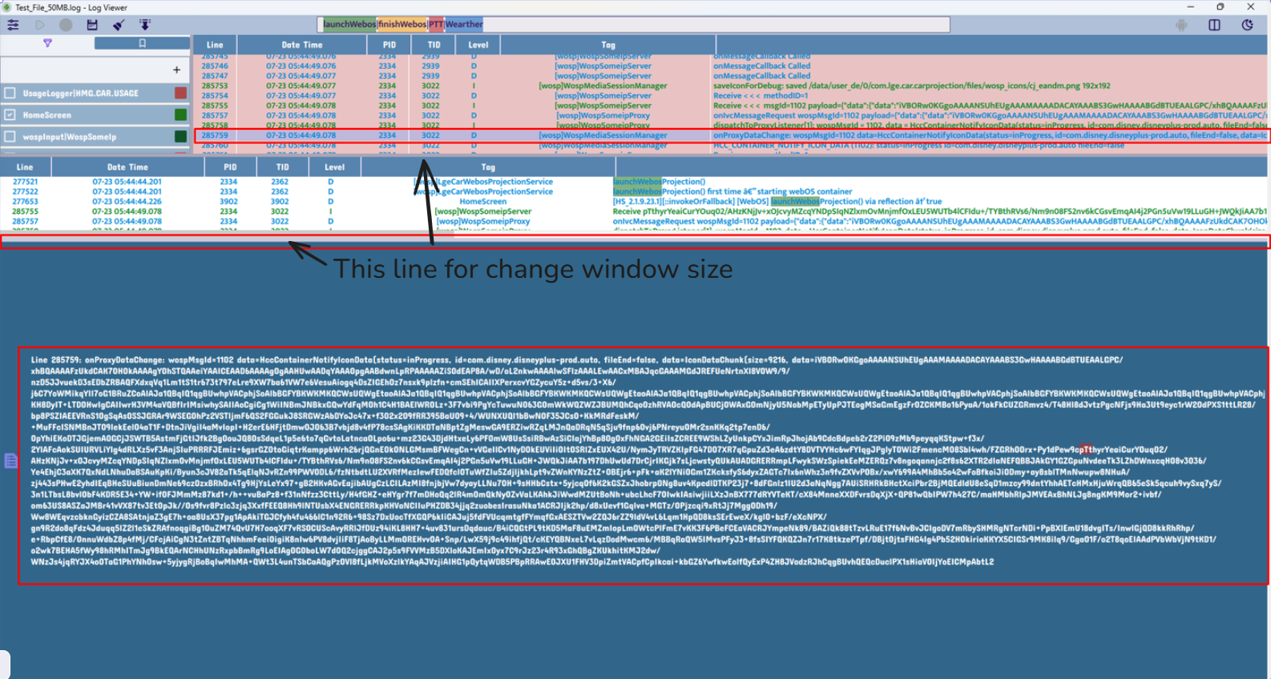
Easy to view when a line of log is long
Can use the whole screen to show a long line of long

Slide 17
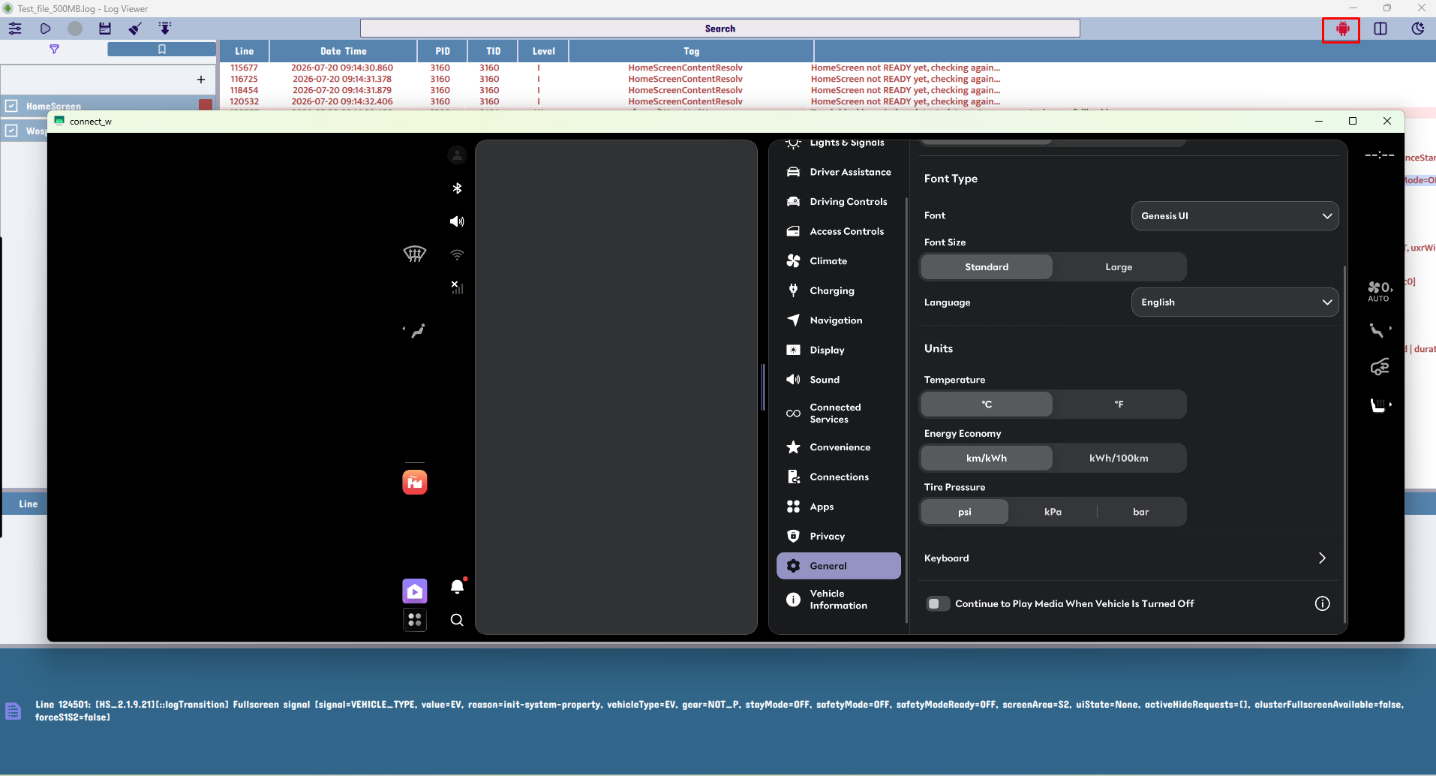
Auto-enable Scrcpy
Smart device integration
When the device is connected, the app automatically enables the screen-copy workflow for a smoother live debugging experience.

Slide 18
Testing & Validation
Validation area | Result
Large log loading | Responsive while reading and parsing huge files
Live stream | Stable updates and auto-scroll control
Filters | Fast matching and color grouping
Search | Highlight multiple keywords correctly
Bookmarks | Quick jump and persistence
UI behavior | Dark/light theme and table responsiveness
ADB device handling | Auto enable/disable based on connection state

Slide 19
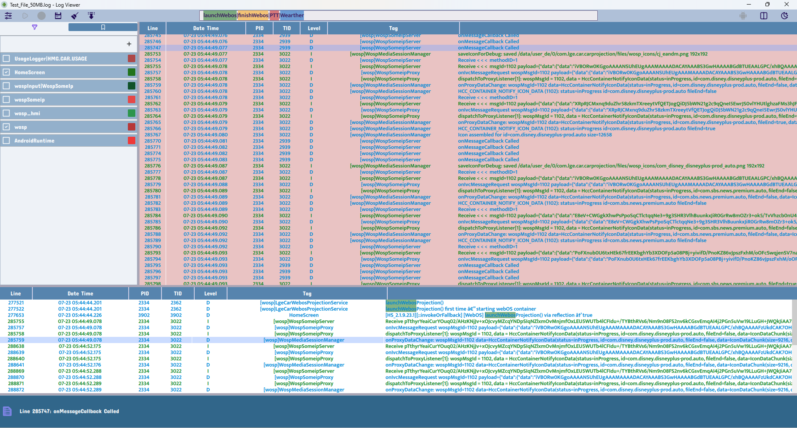
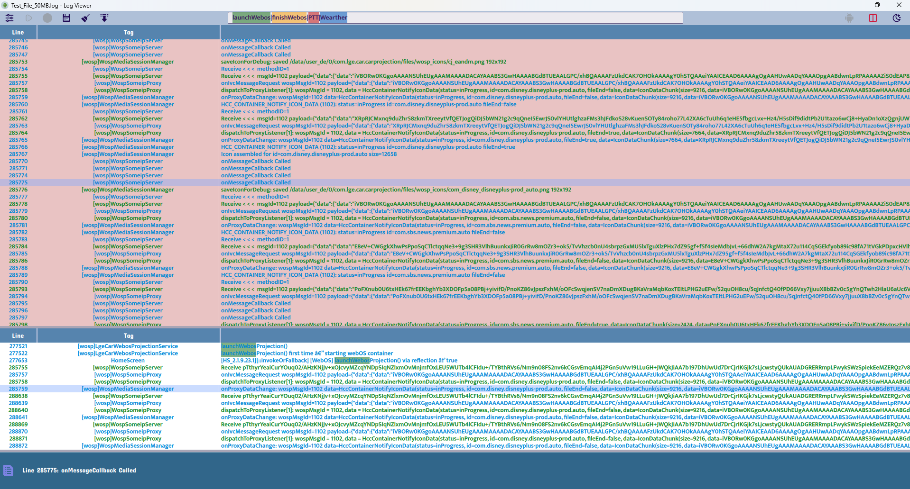
Proof of the New UI and Features
Easy-to-use workflow and improved capability
The updated interface and feature set show a cleaner, more usable, and more efficient debugging workflow.

Slide 20
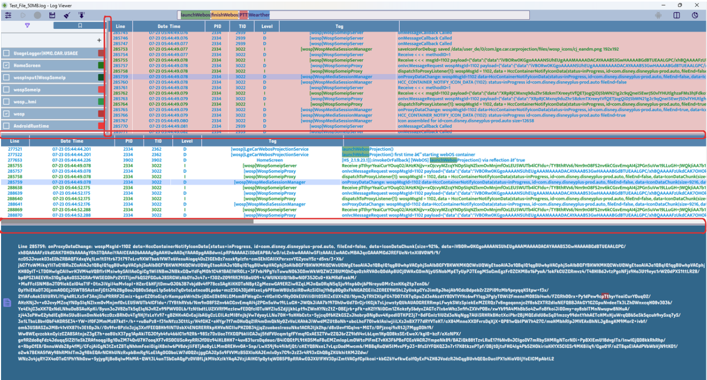
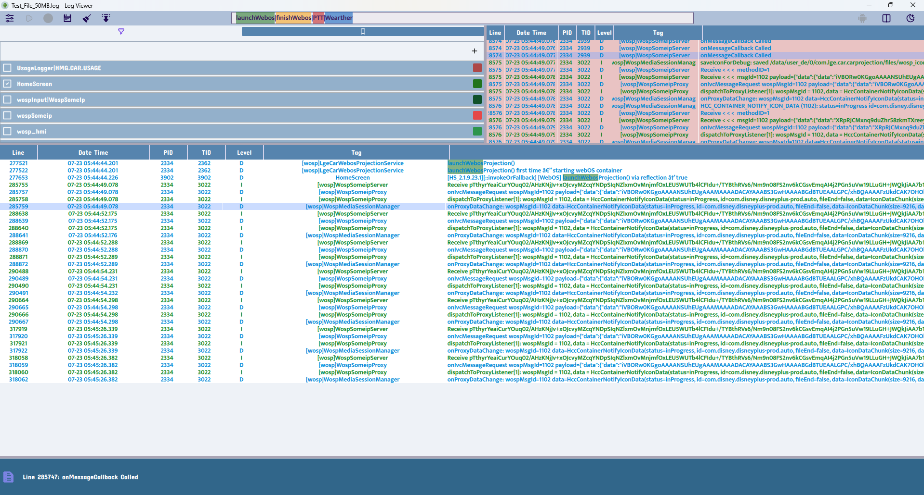
Proof of the New UI and Features
Easy-to-use workflow and improved capability
Easily customize layouts for multiple use cases

Slide 21
Keboard Shortcuts
Project Outcome and Value Delivered
ShortCut | Action
Ctrl + F | Seach
Ctrl + B | Column management
Ctrl + T | Edit the newest filter
Ctrl + Shift + T | Add the new filter
Ctrl + M | Toggle bookmark panel
Ctrl + P | Toggle auto-scroll
Ctrl + Space | Show search history words

Slide 22
Conclusion
Project Outcome and Value Delivered
Smart Device Detection: Automatically enables Start Stream Logcat and Start Screen Copy when an ADB device connects.
Dynamic State Management: Automatically disables these actions when no compatible device is available.
Streamlined UI & UX: Features smooth scrolling, drag-to-open file handling, and an efficient side-panel layout to drastically reduce friction during log analysis.
Continuous Monitoring: A 500MB retention window preserves recent activity, supporting continuous live monitoring without losing critical context.

